Slide 1

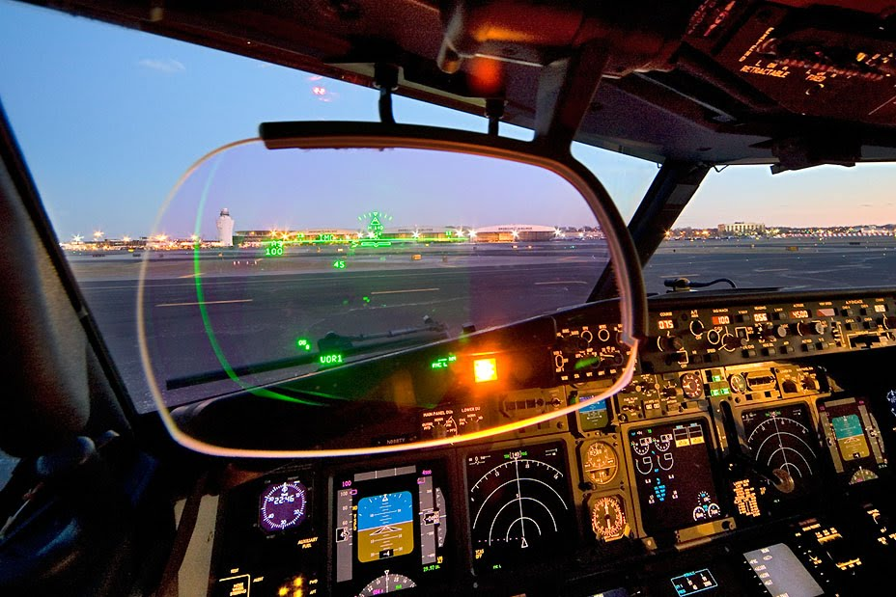
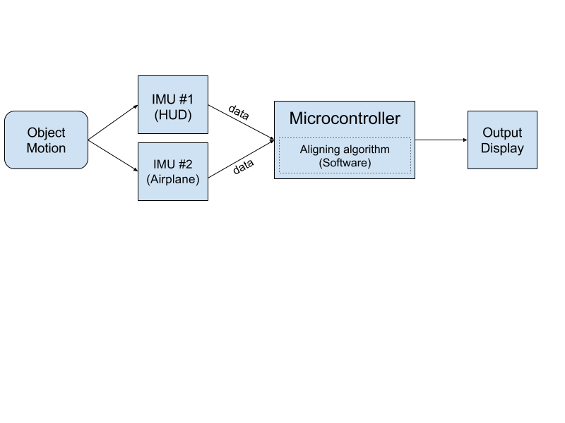
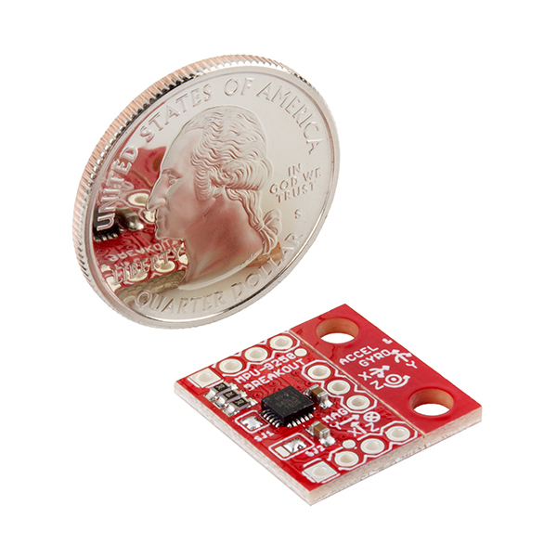
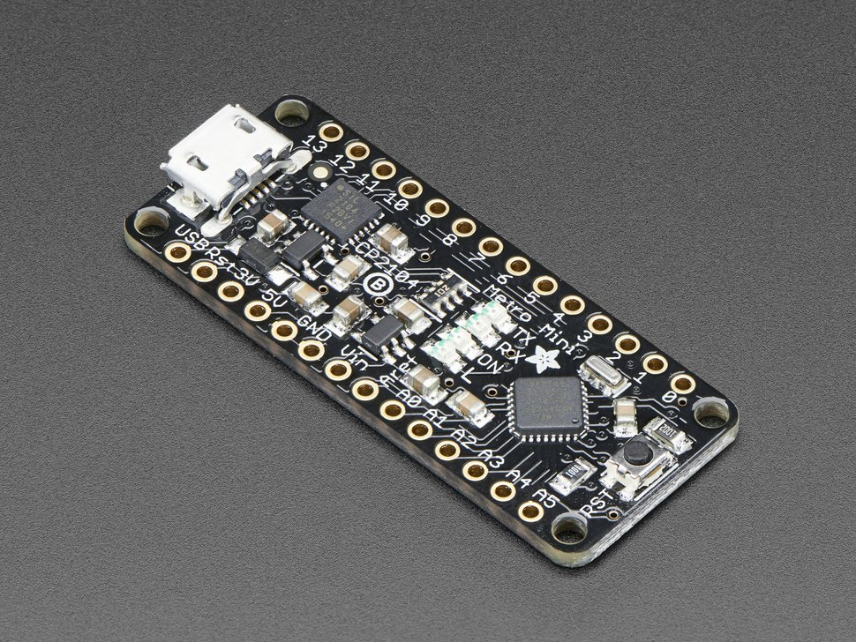
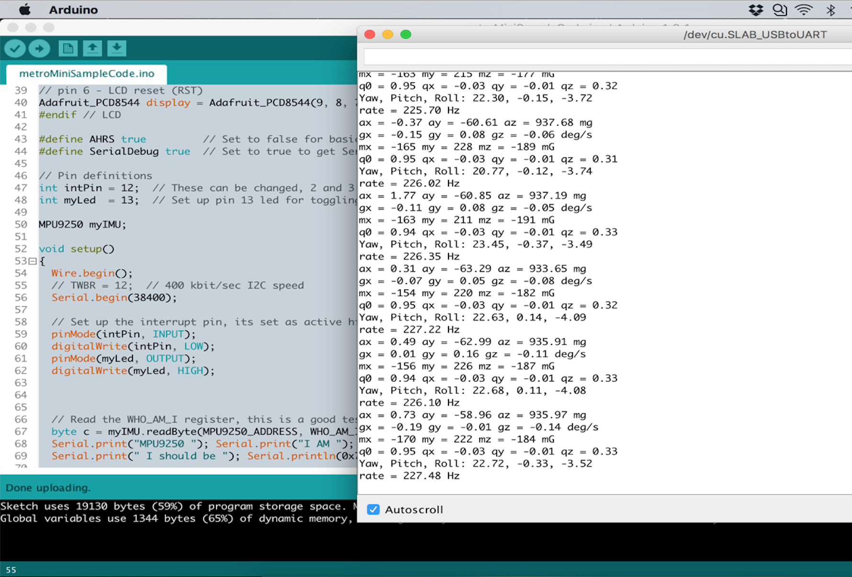
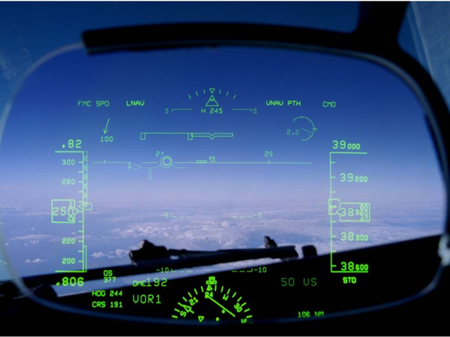

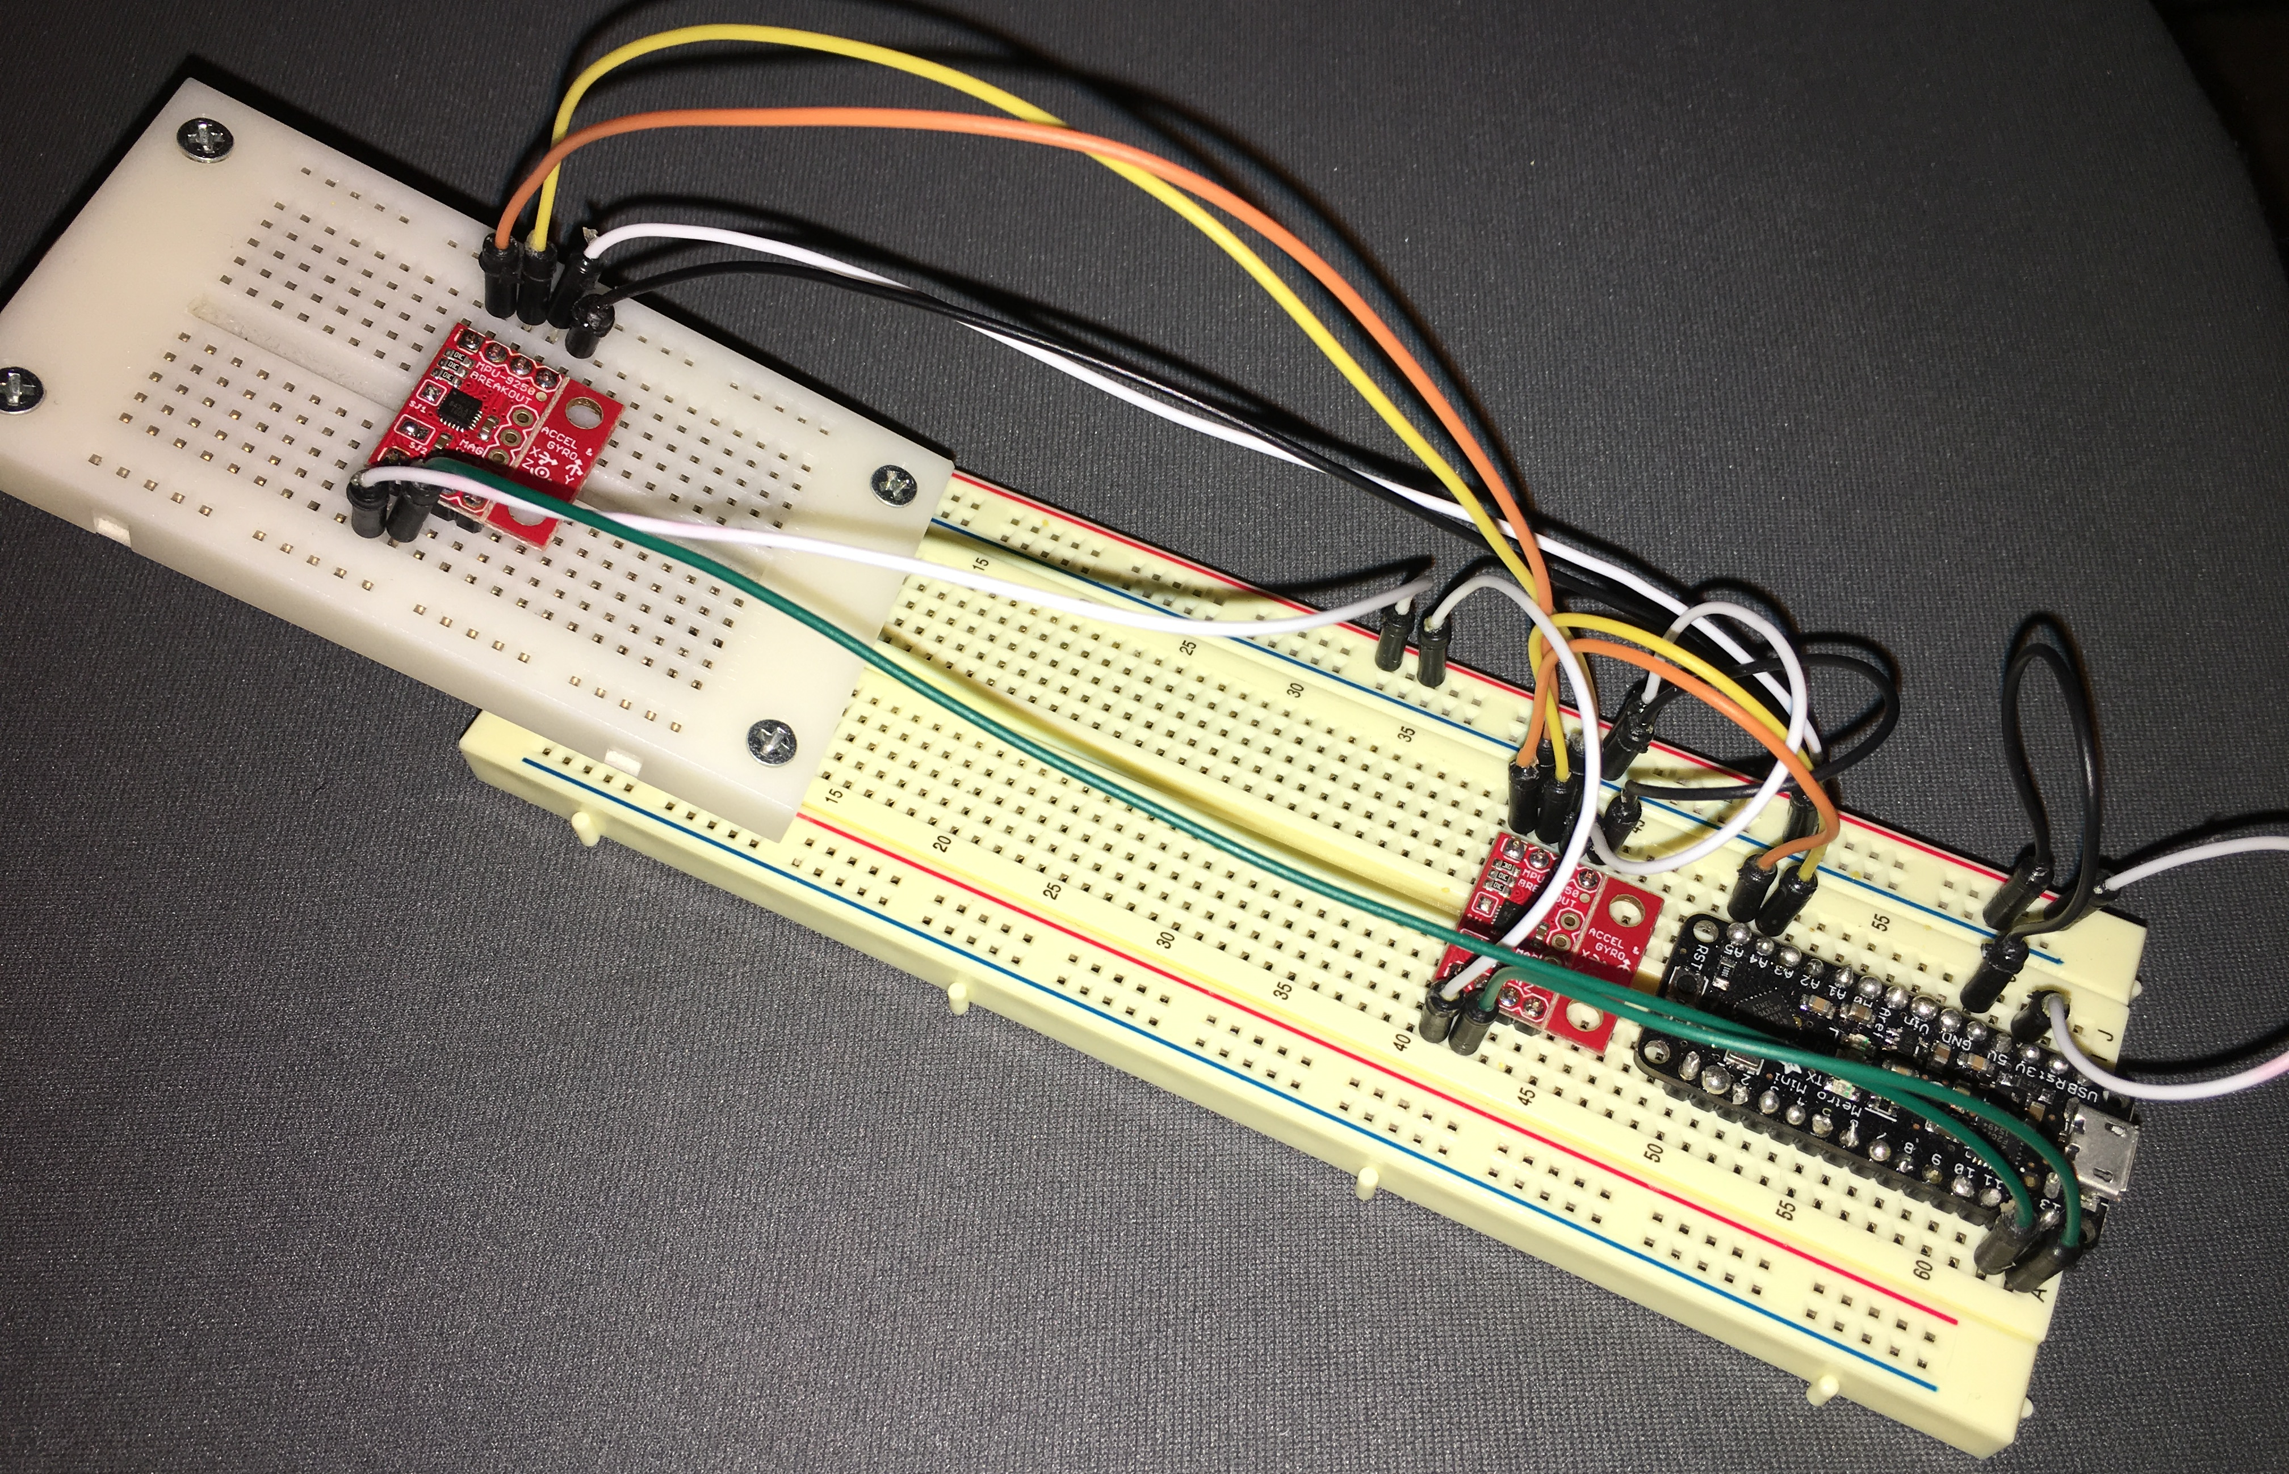
Head-UP Display auto-alignment system
WHAT IS HEAD-UP DISPLAY(HUD)?
A transparent display that is installed in a number of aircraft today. Located in the pilot’s forward field of view, a HUD presents flight information by using graphical, numerical and symbolical data. This device eliminates the need for pilots to continually transition from head-down instruments to head-up, out-the-window view during critical phases of flight.
Meet the Engineers
The cost of an airplane may be reduced in the future!
WHAT IS AN INERTIAL MEASUREMENT UNIT (IMU)?
An IMU contains a set of sensors that typically include an accelerometer, gyroscopes and/or magnetometer (compass). In this project, we used an IMU of model MPU-9250 from Sparkfun Electronics. An MPU-9250 IMU is as tiny as a quarter, yet it contains all three of the sensors mentioned above. A diverse set of sensors increases the degrees of freedom which improves data accuracy. In addition, in order to retrieve sensor data, we also used a microcontroller of model Metro-Mini 328 from Adafruit Industry to communicate with the IMU.
HOW DID WE SOLVE THE PROBLEM?
Our demonstration system made use of two separate IMUs to generate the data that represents the individual points of origin for both the HUD and aircraft. Along with the IMUs, we used a microcontroller to process data and a PC to display the results.
Group Members (Group #65)
Krisna Irawan - irawank@oregonstate.edu
Jiongcheng Luo – luojio@oregonstate.edu
Drew Hamm – 85hammd@oregonstate.edu
Sponsors – Rockwell Collins, Inc.
Brandon Wilson
Weston Lahr
Data flow between hardware components
By using a communication protocol we were able to access each IMU from the microcontroller. A separate method of communication was used to send data from the microcontroller to the PC. We used the Arduino development environment to program the microcontroller as well to debug data output.
Pilot’s forward field of view
CURRENT HUD ALIGNMENT SYSTEM
Currently, a HUD obtains data from an aircraft’s Inertial Reference Unit (IRU). To display precise and accurate information, the HUD must be carefully aligned to the IRU during installation. However, the current HUD installation process requires specialized equipment and epoxy which is time consuming, costly, and interrupts production line progress for the manufacturer.
IMU - Sparkfun MPU-9250
Microcontroller – Metro-Mini 328
PROJECT OVERVIEW
Our project serves as a proof of concept for a new alignment methodology. This project is separated into three parts.
The configuration of hardware and communication between devices.
The development of an program that can find the HUD’s alignment offset in relation to the aircraft.
The design and implementation of a demonstration interface that visually presents the alignment results.
Reading IMU data in Arduino Development Environment
HYPOTHETICAL OUTCOME
Although we were not able to test the system using a real HUD on an aircraft, our project demonstrates how an inexpensive IMU can be used to accurately find an offset in alignment. This new alignment methodology points to a departure from the current HUD installation process by utilizing HUD mounted IMUs. Overall, this system proves that there is an opportunity to substantially cut HUD installation costs in the future.
Each IMU was configured to output its individual sensor data after going through a calibration process. Data was retrieved from each sensor and used to determine the alignment offset through statistical analysis. The results were then sent to the PC to be displayed.
Head-Up Display during flight
NEW ALIGNMENT METHODOLOGY
The goal of this project is to improve the current HUD alignment systems by reducing the installation cost and time required to precisely align flight information to the HUD. Our client, Rockwell Collins, seeks a new alignment methodology that utilizes HUD mounted inertial measurement units.
WHY THIS SOLUTION WORKS?
This solution works in the same general way that is already used in practice. The current practice uses a set of tools that measure the offset between the HUD and the aircraft. The primary difference in our solution is that the tools we use (microcontroller connected to IMUs) is much cheaper than the alternative.
Flowchart
Microcontroller wired to two IMUs
Notes:
If tri-fold mounting at SMS – make sure no text or image is in-between the two vertical guide lines; this space will be cut away. To view the vertical guide lines: Select “View” from the main menu, select “Guides” from the pull down menu, and lastly select “Static Guides”.

